Slide 1
Trabalho Voluntário
Liz Viana Bohn

Slide 2
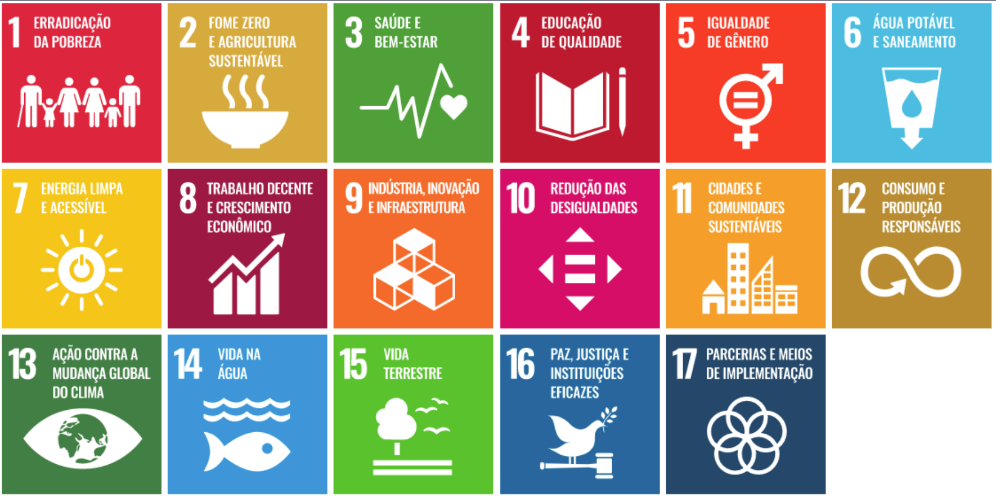
Objetivos de Desenvolvimento Sustentável

Slide 3
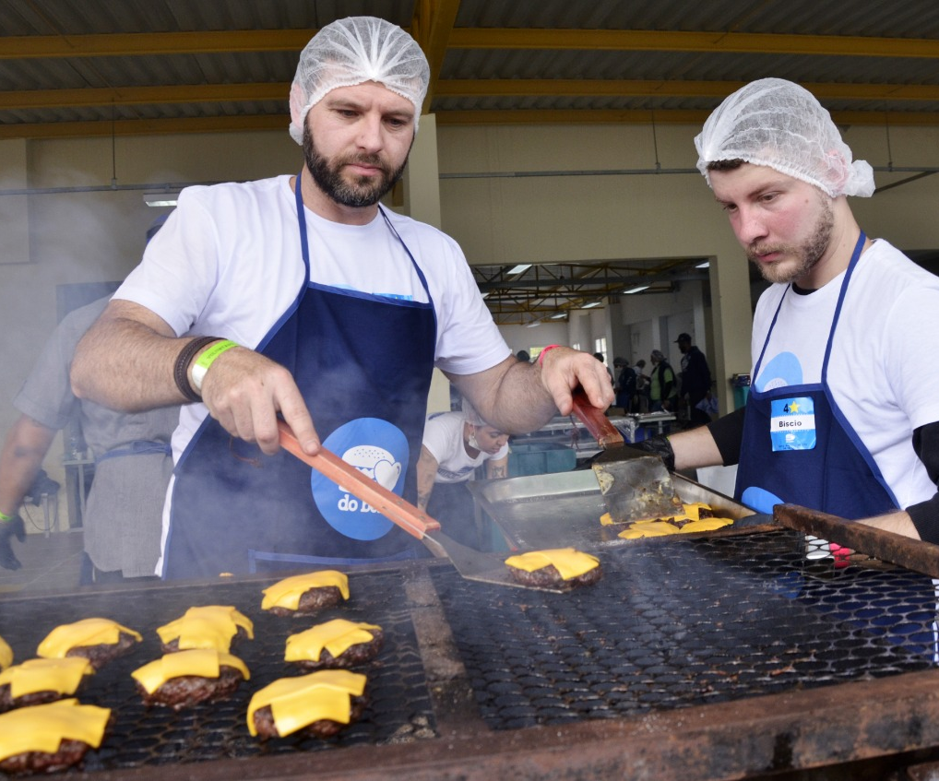
Contexto: por que o voluntariado é importante?
Transformação Pessoal
Construção de Comunidade
Empatia e Compaixão
Desenvolvimento de Habilidades
Impacto Duradouro
Senso de Realização
Voluntários produzindo hambúrguer para crianças
carentes | Hambúrgada do Bem

Slide 4
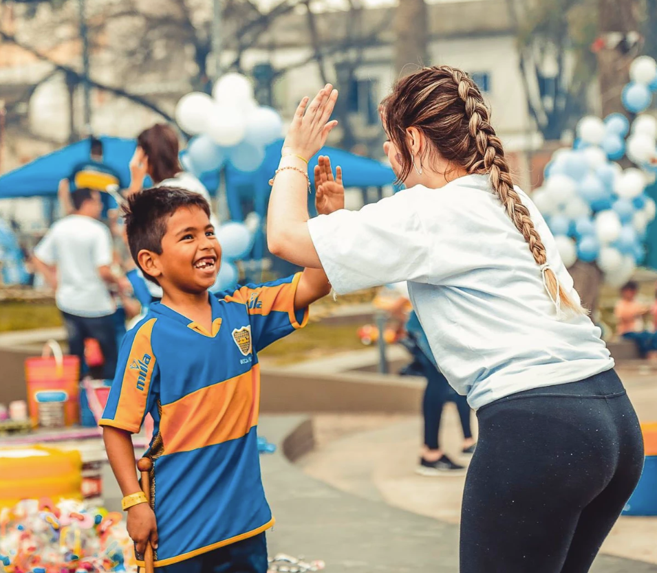
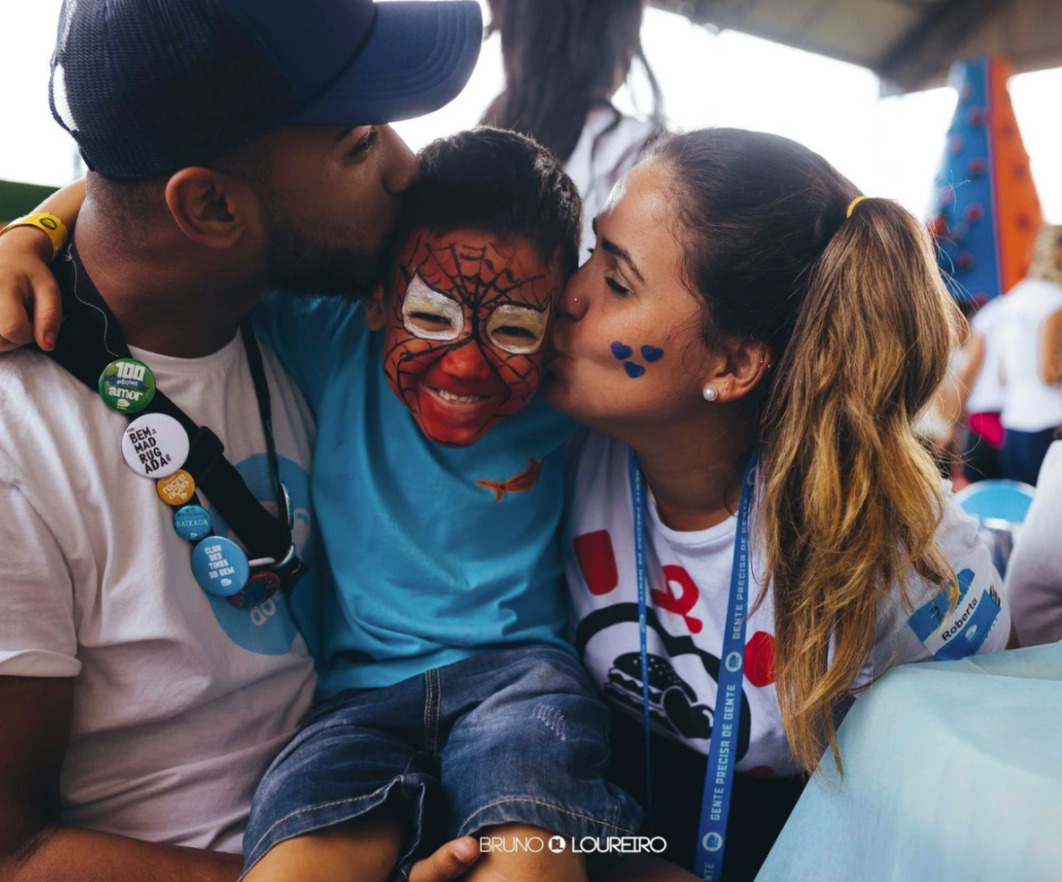
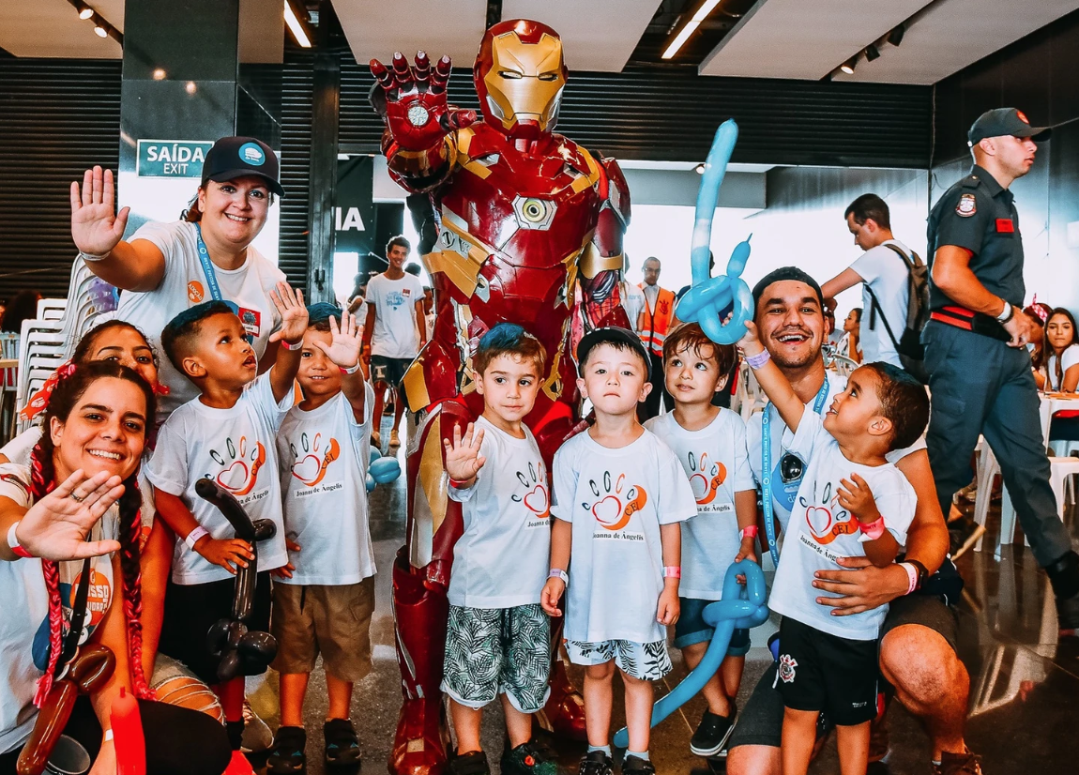
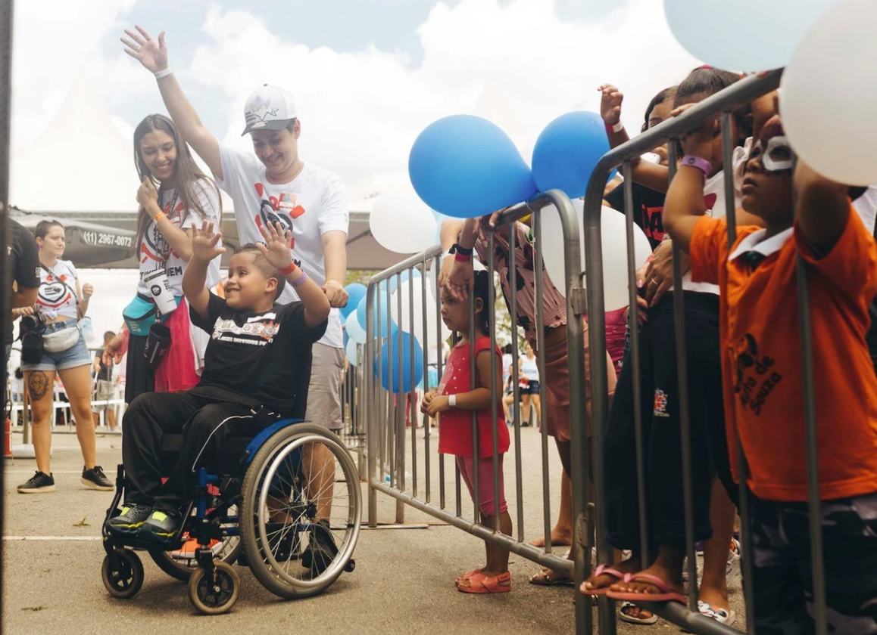
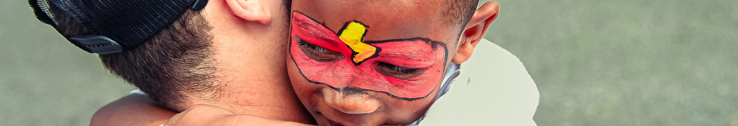
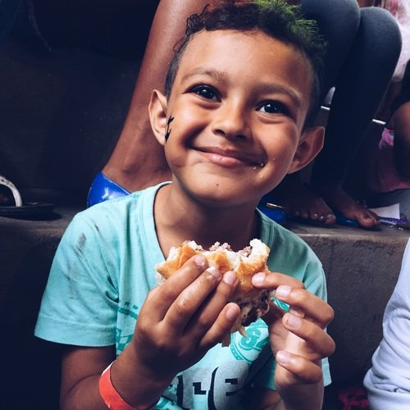
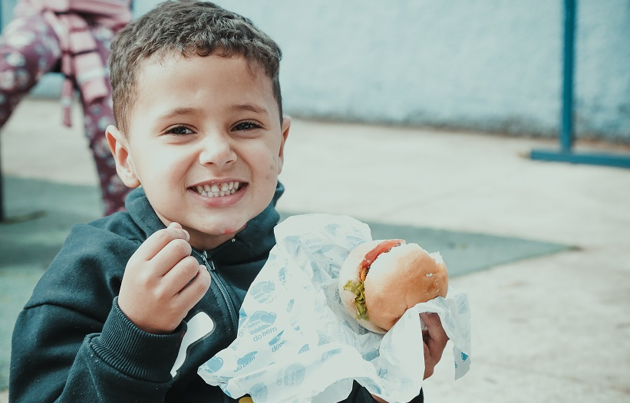
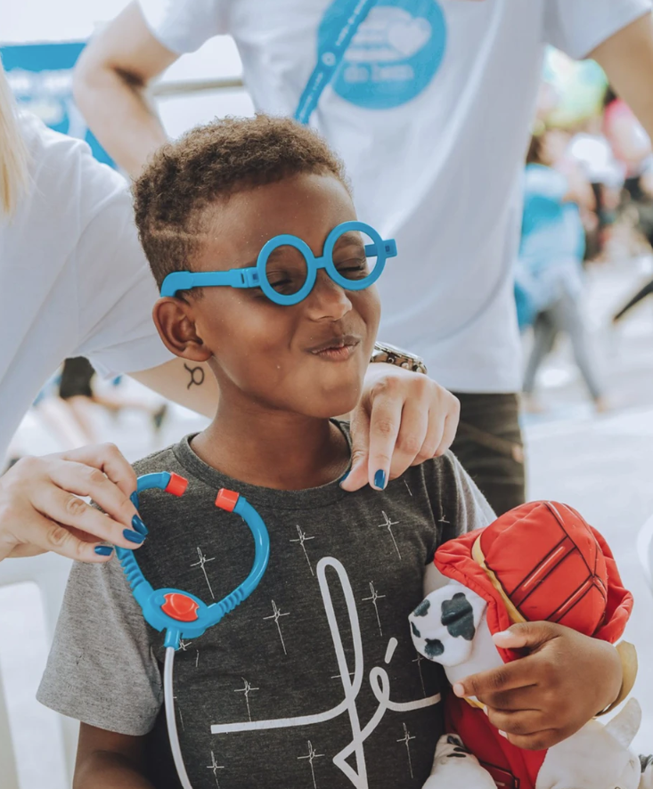
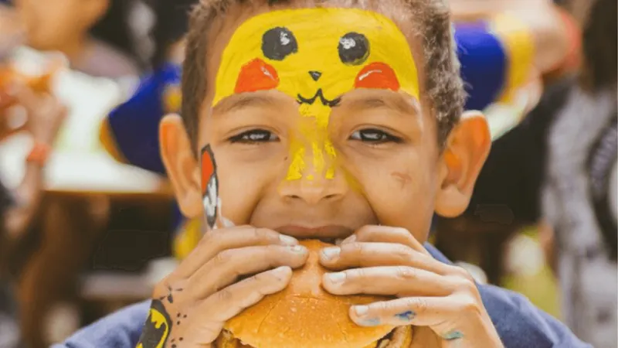
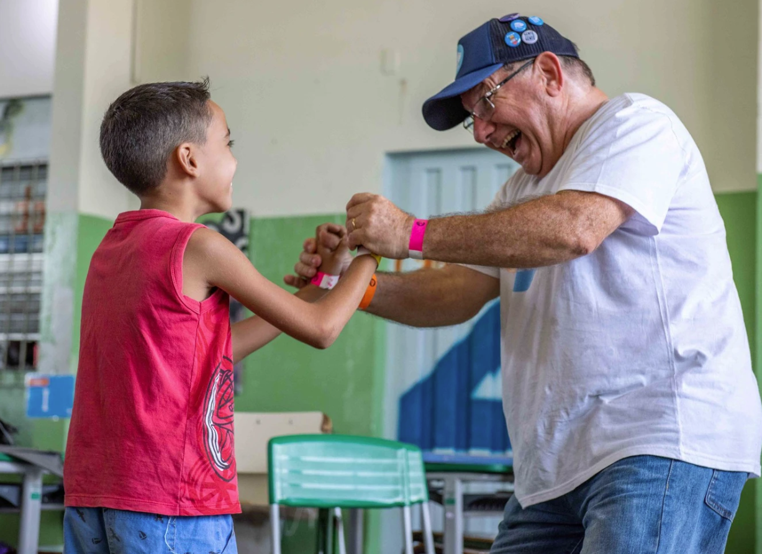
Trabalho voluntário com crianças

Slide 5
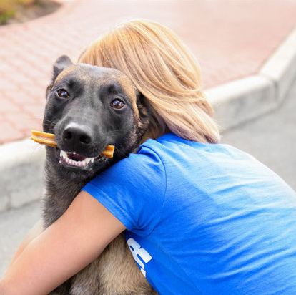
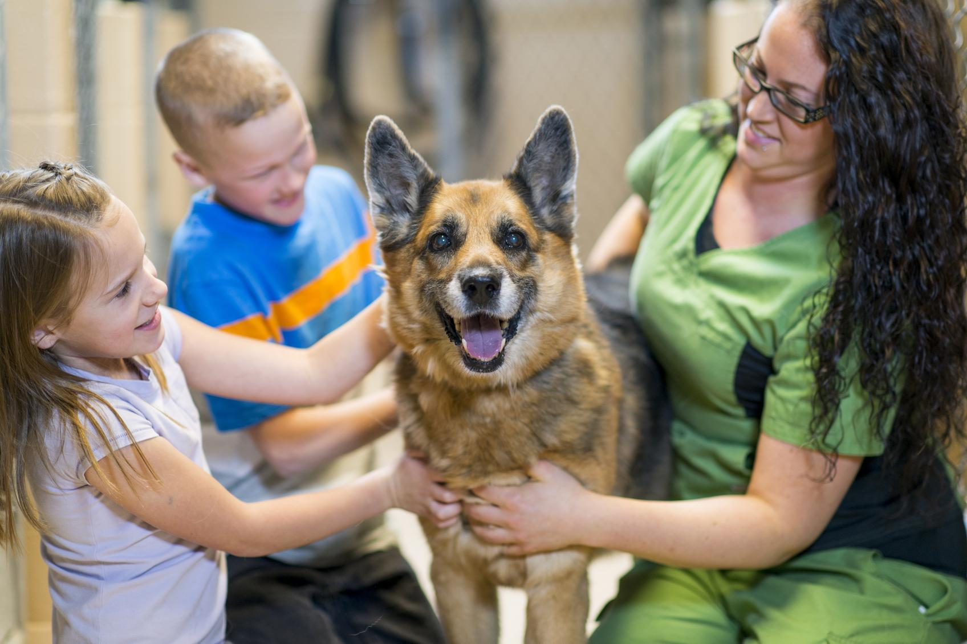
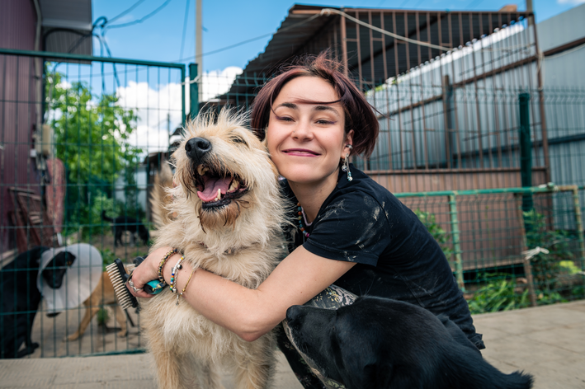
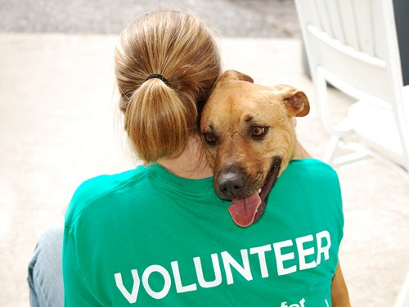
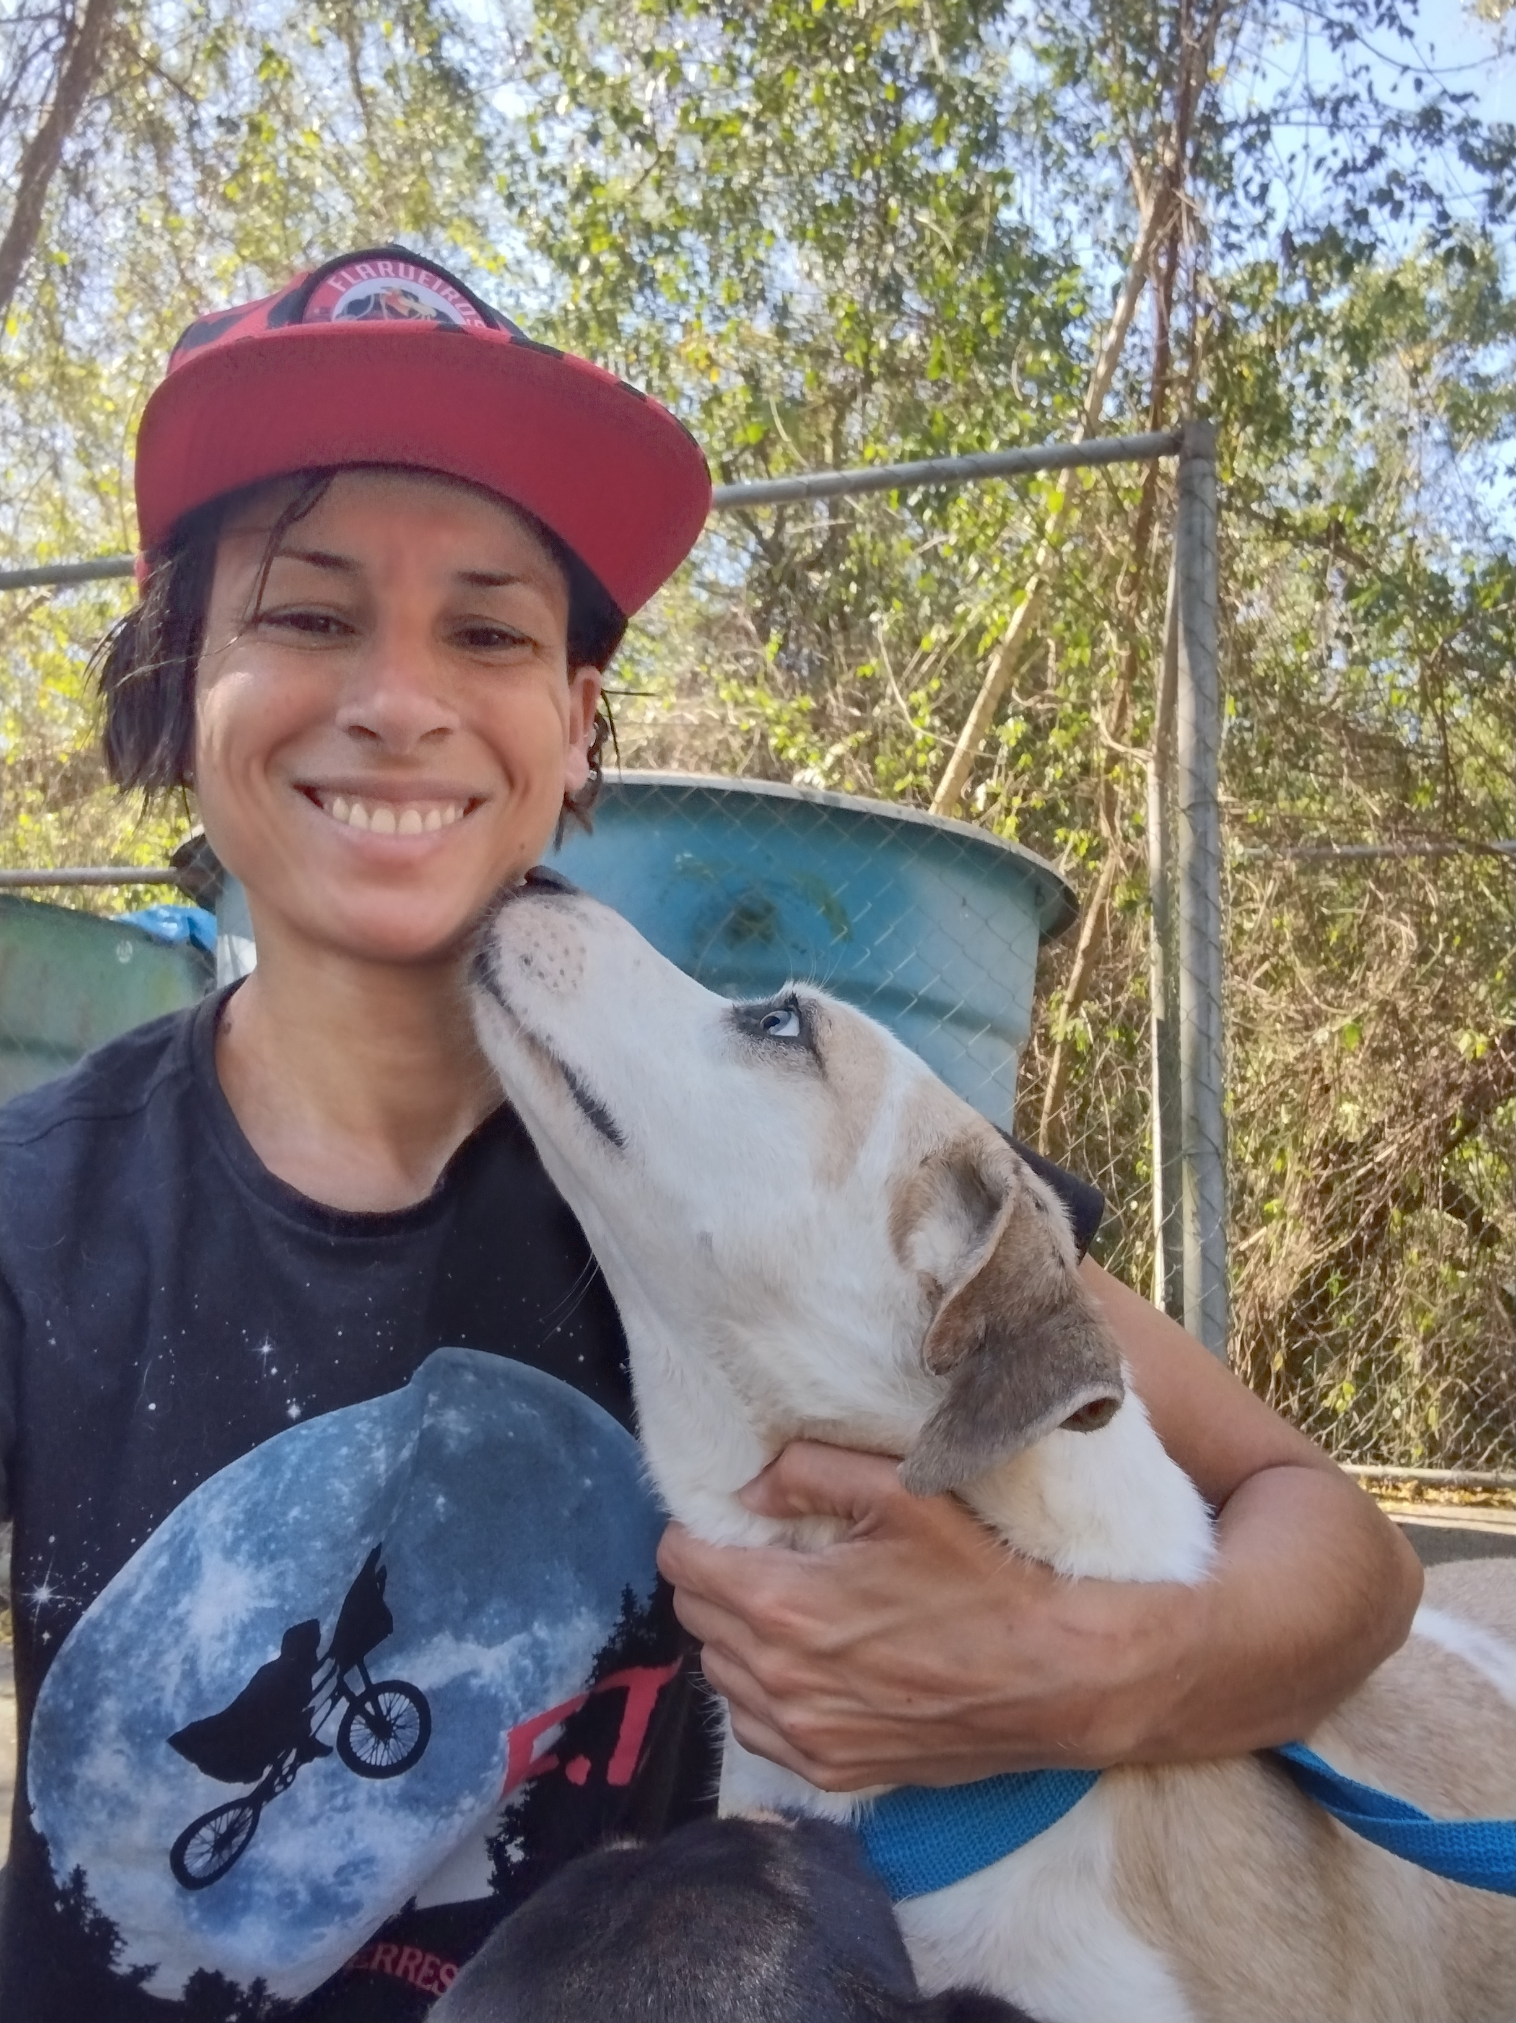
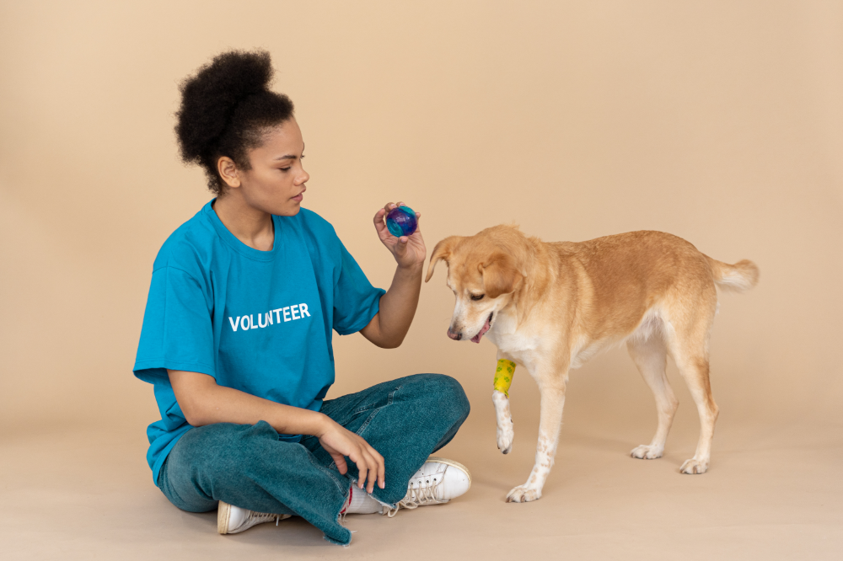
Trabalho voluntário com animais

Slide 6
Desafios: o que é difícil?
Expectativa e Desilusão
Impacto Emocional
Cansaço e Burnout
Conflitos e Frustrações
Limitações de Recursos
Equilíbrio de Tempo

Slide 7
Valores pessoais
01
02
03
04
Empatia
Solidariedade
You can describe the topic of the section here
You can describe the topic of the section here
Compromisso
Respeito pela Diversidade
You can describe the topic of the section here
You can describe the topic of the section here
05
06
Generosidade
Crescimento Pessoal
You can describe the topic of the section here
You can describe the topic of the section here

Slide 8
“A verdadeira medida da vida não está em quanto temos, mas em quanto damos. Cada ato de voluntariado é uma semente de esperança plantada no coração de alguém…”

Slide 9
Minha Linha da Vida e o Despertar para o Voluntariado
As Raízes do Meu Interesse
O Primeiro Contato com a Doação
Escolha da Profissão e Conexão com o Voluntariado
Voluntariado no Dia a Dia
Por Que Escolhi Este Tema?
Adicionar imagens pessoais: hamburgada
+ vet

Slide 10
Whoa!
This can be the part of the presentation where you introduce yourself, write your email…

Slide 11
01
Name of the section
You can enter a subtitle here if you need it

Slide 12
The slide title goes here!
Do you know what helps you make your point crystal clear? Lists like this one:
They’re simple
You can organize your ideas clearly
You’ll never forget to buy milk!
And the most important thing: the audience won’t miss the point of your presentation

Slide 13
Maybe you need to divide the content
Mercury
Venus
Mercury is the closest planet to the Sun and the smallest one in the Solar System—it’s only a bit larger than the Moon
Venus has a beautiful name and is the second planet from the Sun. It’s hot and has a poisonous atmosphere

Slide 14
Here are three important ideas
Mercury
Venus
Mars
Mercury is the closest planet to the Sun and the smallest of them all
Venus has a beautiful name and is the second planet from the Sun
Despite being red, Mars is actually a cold place. It’s full of iron oxide dust

Slide 15
Divide the content in different points
Mars
Saturn
Venus
Jupiter
Despite being red, Mars is actually a cold place
Saturn is a gas giant and has several rings
Venus has extremely high temperatures
Jupiter is the biggest planet of them all

Slide 16
Reasons to volunteer
Mars
Venus
Neptune
Mars is actually a very cold place
Venus has extremely high temperatures
Neptune is the farthest planet from the Sun
Mercury
Saturn
Jupiter
Mercury is the closest planet to the Sun
Saturn is a gas giant with several rings
Jupiter is the biggest planet of them all

Slide 17
Awesome words

Slide 18
—Someone Famous
“A verdadeira medida da vida não está em quanto temos, mas em quanto damos. Cada ato de voluntariado é uma semente de esperança plantada no coração de alguém…”

Slide 19
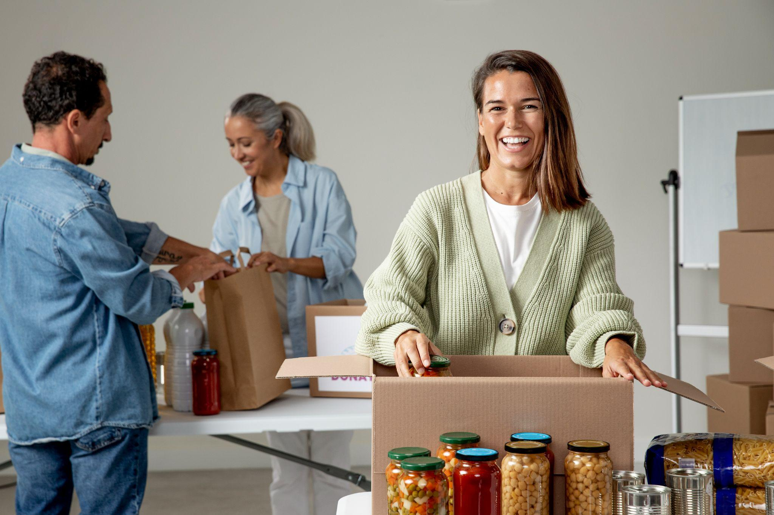

Our team
Sofia Hill
Timmy Jimmy
You can speak a bit about this person here
You can speak a bit about this person here

Slide 20
4,498,300,000
Big numbers catch your audience’s attention

Slide 21
9h 55m 23s
333,000
386,000 km
Jupiter's rotation period
The Sun’s mass compared to Earth’s
Distance between Earth and the Moon

Slide 22
Use of percentages
25%
50%
75%
Mercury
Venus
Mars
Mercury is the closest planet to the Sun and the smallest of them all
Venus has a beautiful name and is the second planet from the Sun
Despite being red, Mars is actually a cold place. It’s full of iron oxide dust

Slide 23

Computer mockup
You can replace the image on the screen with your own work. Just right-click on it and select “Replace image”

Slide 24
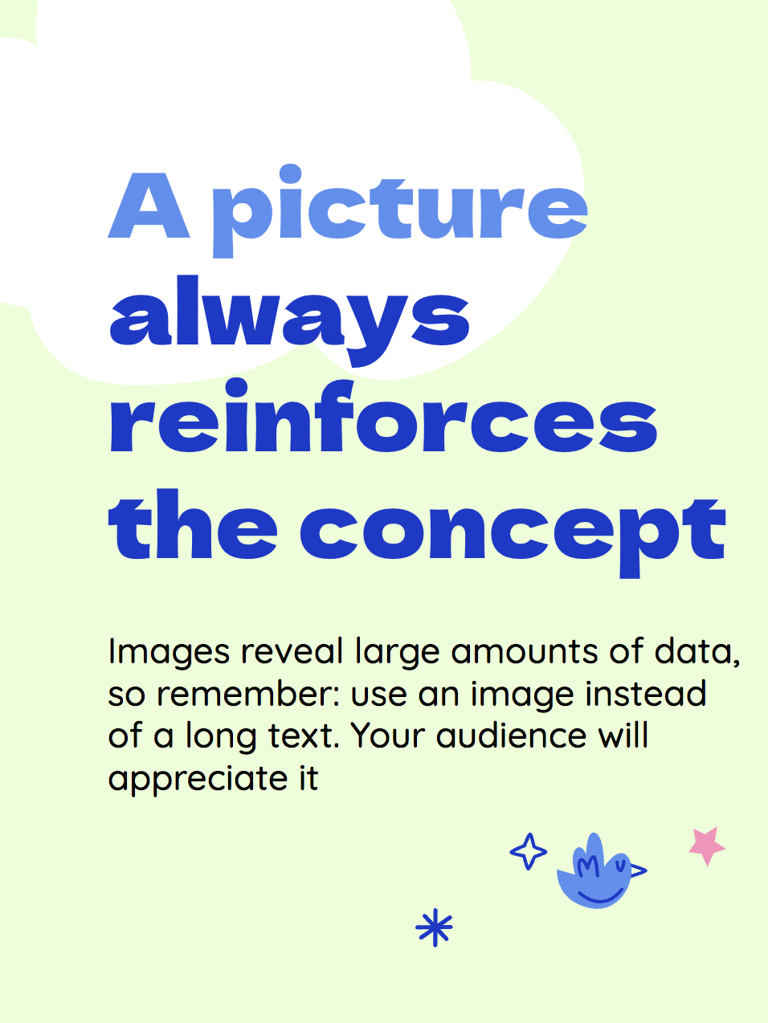
Tablet mockup
You can replace the image on the screen with your own work. Just right-click on it and select “Replace image”

Slide 25

Phone mockup
You can replace the image on the screen with your own work. Just right-click on it and select “Replace image”

Slide 26
Main celebration events
Venus
Mercury
Mars
Venus is the second planet from the Sun
Mercury is the closest planet to the Sun
Despite being red, Mars is a very cold place

Slide 27
Steps to sign up to volunteer
Phase 2
Phase 4
Venus is the second planet from the Sun
Jupiter is the biggest planet of them all
Phase 1
Phase 3
Mercury is the closest planet to the Sun
Despite being red, Mars is a very cold place

Slide 28
Infographics are very visual
Mars
Venus
Mars is actually a very cold place
Venus has extremely high temperatures
Mercury
Saturn
Mercury is the closest planet to the Sun
Saturn is a gas giant and has several rings

Slide 29
Tables represent your data
 | Donations | Start | Ending
Project 1 | $25,205 | 14 March | 20 May
Project 2 | $5,100 | 7 September | 12 October
Project 3 | $934 | 2 October | 12 December

Slide 30
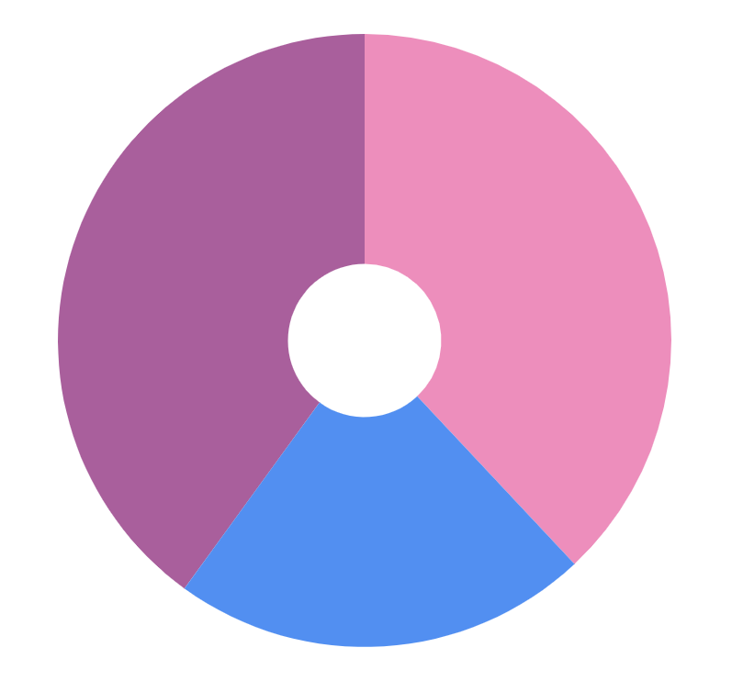
You can use this graph
Venus
Saturn
Jupiter
38%
Venus has very high temperatures
22%
Saturn is a gas giant with rings
40%
Follow the link in the graph to modify its data and then paste the new one here. For more info, click here
Jupiter is the biggest planet

Slide 31
Personal card of the volunteer
Expertise
Availability
Venus is the second planet from the Sun
Despite being red, Mars is a very cold place
Skills
Projects
Mercury is the closest planet to the Sun
Jupiter is the biggest planet in the Solar System

Slide 32
02
Name of the section
You can enter a subtitle here if you need it

Slide 33
Success stories
Case 1
Case 2
Case 3p
Mercury is the closest planet to the Sun and the smallest of them all
Venus has a beautiful name and is the second planet from the Sun
Despite being red, Mars is actually a cold place. It’s full of iron oxide dust

Slide 34
Our timing
1
2
3
4
5
Jan
Apr
Jul
Sep
Nov
Saturn has several rings
Venus is terribly hot
Mars is actually cold
Neptune is far from the Sun
Jupiter is a gas giant

Slide 35
Volunteering events
Status | Date | Activity | Description
✔ | 14 March | Venus | Venus has extremely high temperatures
✔ | 19 September | Mars | Mars is actually a very cold place
✖ | 2 October | Mercury | Mercury is the closest planet to the Sun
✖ | 7 December | Saturn | Saturn is a gas giant and has several rings

Slide 36
Roles of the volunteer team
Training
Coordination
Communication
Management
Recruitment
Logistics

Slide 37
Event calendar
Event 1
Event 2
M | T | W | T | F | S | S
01 | 02 | 03 | 04 | 05 | 06 | 07
08 | 09 | 10 | 11 | 12 | 13 | 14
15 | 16 | 17 | 18 | 19 | 20 | 21
22 | 23 | 24 | 25 | 26 | 27 | 28
29 | 30 | 31
16
Despite being red, Mars is a very cold place
26
Saturn is a gas giant and has several rings

Slide 38
Thanks!
Do you have any questions?
youremail@freepik.com
+34 654 321 432
yourwebsite.com
Please keep this slide for attribution

Slide 39
Resources
Did you like the resources on this template? Get them for free at our other websites:
Vectors
Hand drawn doodle charity sticker set I
Hand drawn doodle charity sticker set II
Hand drawn doodle charity sticker set III
Hand drawn doodle charity sticker set IV
Photos
Volunteer and beach concept
Volunteers with food donations close up
Medium shot people with donations
Medium shot smiley people donating food

